Slide 1
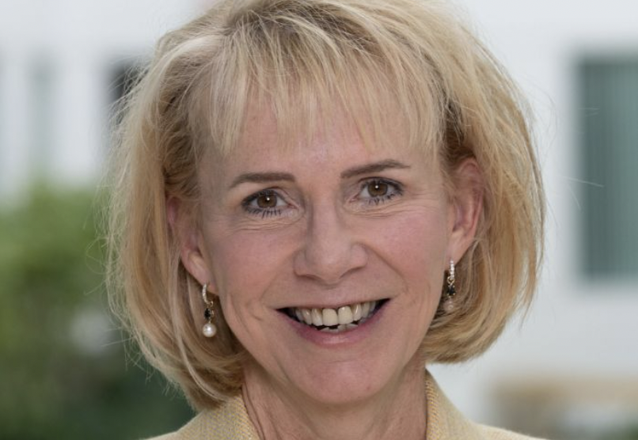
Michigan Future Inc. adds Dr. Kimberly Andrews Espy to Board of Directors

